Slide 1
US Army Corps of Engineers,
Albuquerque District (SPA)
Small Business Industry Day
SPA Program Overview
John R. D’Antonio Jr., P.E.
Deputy District Engineer
Programs & Project Management

Slide 2
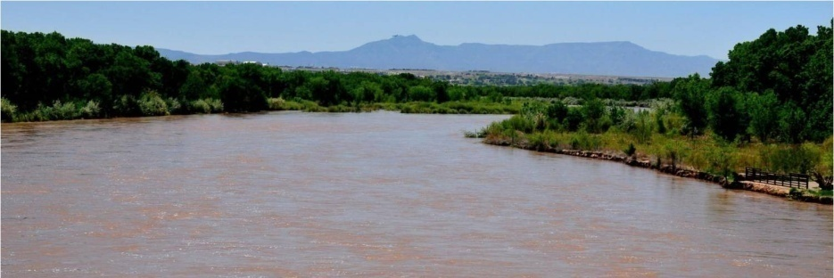
Mission
USACE Mission
Provide vital public engineering services in peace and war to strengthen our Nation’s security, energize the economy and reduce risks from disasters.
South Pacific Division Mission
Build on new and emerging engineering solutions, and our enduring standards of excellence, to deliver quality projects and services, and respond to National emergencies with our partners and stakeholders, through inspired leadership, a world-class workforce, and an enriched culture of discipline and innovation, to strengthen our Nation.
Albuquerque District Mission
Strengthen our Nation by providing responsive, innovative, and sustainable infrastructure and environmental solutions for our Military, IIS, and Civil Works partners and stakeholders, and responding to national emergencies as an engineering leader built to last on valued relationships and standards of excellence.
2
Notes:
2

Slide 3
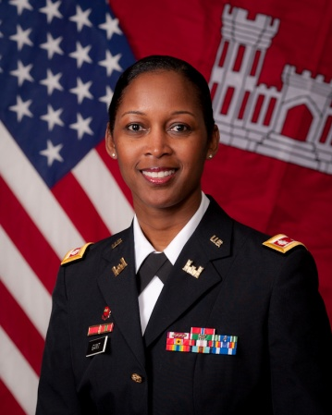
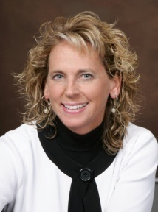
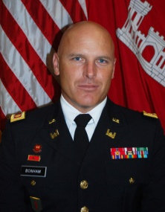
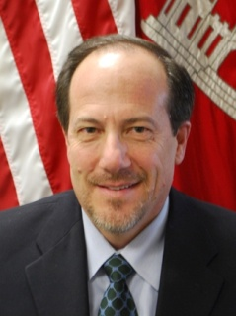
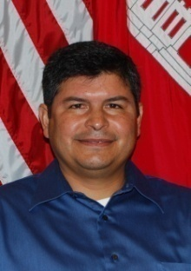
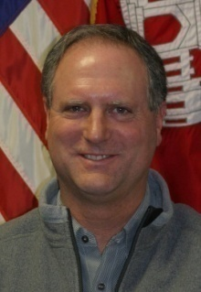
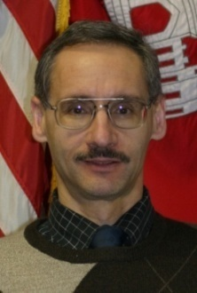
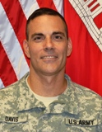
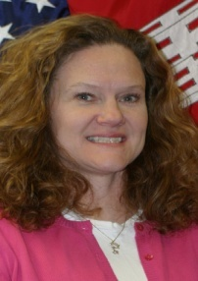
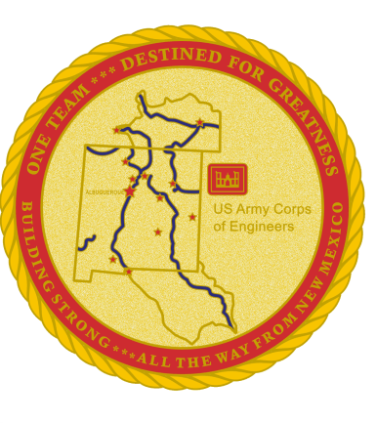
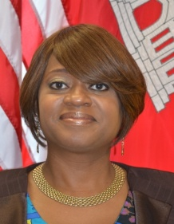
SPA Corporate Team
Commander
Deputy Commander
DPM
Engineering & Construction
Regulatory
MAJ Gary Bonham
Mr. John D’Antonio
Mr. John Moreno
Mr. Allan Steinle
LTC Antoinette Gant
Operations
Contracting
Office of Counsel
Resource Management
Mr. Mark Yuska
LTC Joseph Davis
Ms. LeeAnn Summer
Mrs. Elizabeth McCullough
Dedicated military and civilians serving the Nation…since 1935.
Notes:
3

Slide 4
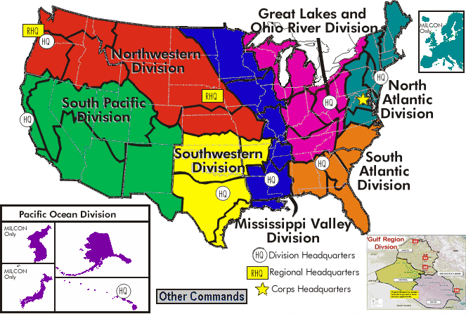
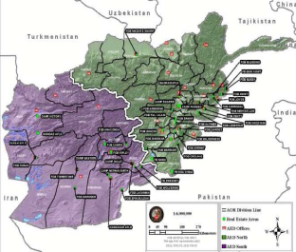
The Corps of Engineers
Established on March 16, 1802
35,000 Civilian employees + 650 Military service members
Divided into 8 Divisions and 41 Districts + GRD
Includes 8 research laboratories
4
Notes:
How many of you have worked for the Corps before? You may know some of this…
The history of United States Army engineers can be traced back to June 16, 1775 (the Army’s birthday), when the Continental Congress organized an army with a chief engineer and two assistants. Colonel Richard Gridley became General George Washington's first chief engineer; however, it was not until March 16, 1802 that Congress created a separate Corps of Engineers (USACE’s birthday).
The United States Army Corps of Engineers (USACE) is made up of approximately 34,600 Civilian and 650 military members. USACE’s mission is to provide quality, responsive engineering services to the nation including:
Planning, designing, building and operating water resources and other civil works projects (Navigation, Flood Control, Environmental Protection, Disaster Response, etc.)
Designing and managing the construction of military facilities for the Army and Air Force. (Military Construction)
Providing design and construction management support for other Defense and federal agencies. (Interagency and International Services)
USACE is headed by the Chief of Engineers, LTG Van Antwerp. Headquarters, USACE office defines policy and guidance and plans direction for the organizations within the Corps.
The Corps is organized geographically into 8 permanent divisions in the US, plus a provisional Gulf Region Division (GRD) overseas. There are 45 subordinate districts throughout the US, Asia and Europe, three of which are provisional offices in Iraq and Afghanistan. The districts oversee project offices throughout the world. Divisions and districts are defined by watershed boundaries, not by states. In addition, a 9th provisional division with four districts was activated January 25, 2004, to oversee operations in Iraq and Afghanistan.
The Engineer Research and Development Center (ERDC) is the US Army Corps of Engineers research and development command. ERDC consists of eight unique laboratories. Research support includes: Mapping and terrain analysis, Infrastructure design, construction, operations and maintenance, Structural engineering, Cold regions and ice engineering, Coastal and hydraulic engineering, Environmental quality, Geotechnical engineering, and High performance computing and information technology

Slide 5
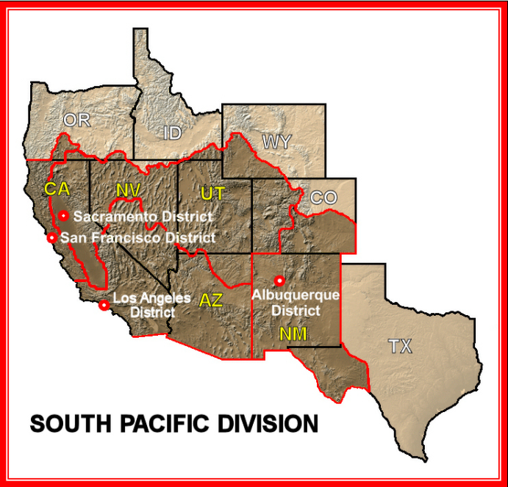

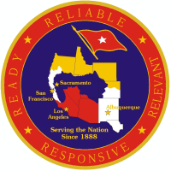
Common Regional Picture
10 States (5 shared with other regions)
One of the 10 Largest Economies in the World
10 of the Nation’s Fastest Growing States / Cities
Approximately 18,000 miles of levees
46 Dams & Reservoirs
5 Strategic Ports
30 Areas with Recreation; 15.7M visits annually
300 of 1,200 Threatened / Endangered Species
516 of 1,547 Military Munitions Properties
4 EPA Regions (6, 8, 9, 10)
4 FEMA Regions (6, 8, 9, 10)
4 VA Integrated Service Networks (18, 19, 21, 22)
3 US Fish & Wildlife Service Regions (1, 2, 6)
1 National Marine Fisheries Office
13 Army & 12 Air Force Programs / Installations
170 Native American Nations
81 US Congressional Representatives
20 US Senators
South Pacific Division
5
Notes:
South Pacific Division Common Regional Picture (CRP)
Characterized by a vast number of waterways, navigable rivers, ports, harbors, and wetlands; COE for Flood Risk Management.
10 of the Nation’s Fastest Growing States / Cities.
46 Dams & Reservoirs
18,000 miles of levees:
18% of total nation-wide levees.
2,367 miles in Rehab Inspection Program (RIP) / 2,286 miles are Federal Levees.
5 Strategic Ports (Dept. of Homeland Security; Port Security requirements): POLA, POLB, San Diego, Oakland & Richmond.
Large number of parks and recreational areas (some leased); over 15M visitors annually.
One-fourth of our nation’s threatened/endangered species (birds, bugs, and bunnies).
EPA Region 9: HQ = SF, Laura Yoshee.
FEMA Region 9: HQ = Oakland, Nancy Ward.
13 x USA and 12 x USAF installations/programs.
170 Native American Nations/tribes (New Mexico and Arizona; e.g., Navajo, Pueblo of Santa Ana, Awe-Wing-A).
Healthy Congressional representation (Pelosi, Boxer, Feinstein, Reid, McCain; personally met/interfaced with Congresswoman Napolitano- CA 38th District, Congresswoman Matsui- CA 5th District, and Congressman Pastor- AZ 4th District).
NEXT SLIDE PLEASE

Slide 6
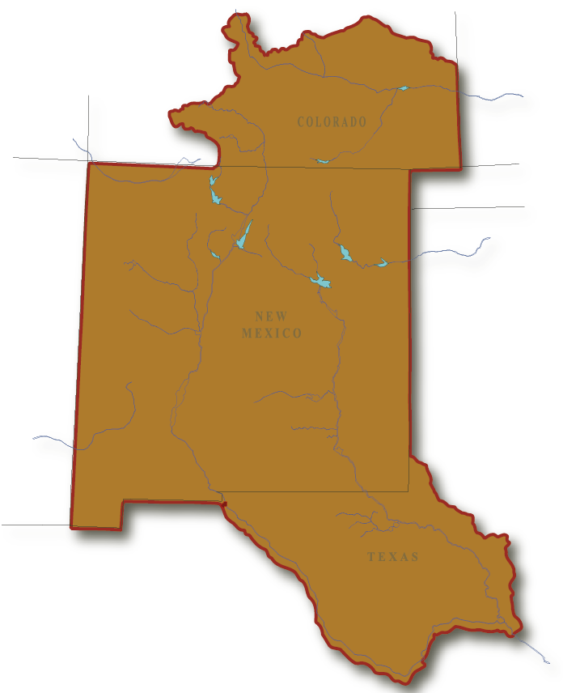
Albuquerque District
Primarily serving 3 States (NM, CO, TX)
6 Senators; 10 Congressional Districts
FY12 Program—$443 Million
Estimated FY 13 Program - $240 Million
Average 379 employees
9 employees deployed in support of OEF
3 Regulatory Field Offices
Manage 9 Flood Risk Management (FRM) Projects; 4 USACE & 8 State Campgrounds; 6.7 Million visits annually
Operate & maintain 9 dams
Support 3 Major Air Force Installations, New Mexico Army National Guard and Army Reserve
4 Construction Resident Offices
Partner with 23 Federally recognized tribes
Pueblo
John Martin
Durango
Trinidad
Abiquiu
LOS ALAMOS
Cochiti
Conchas
Jemez Canyon
Galisteo
Santa Rosa
KIRTLAND AFB
CANNON AFB
Two Rivers
HOLLOMAN AFB
LAS CRUCES
EL PASO
HEADQUARTERS
REGULATORY FIELD OFFICE
DAM PROJECT
RESIDENT OFFICE
FUTURE PROJECT OFFICE

Slide 7
SPA Structure
EXECUTIVE OFFICE
PROGRAMS & PROJECT MGMT
ENGINEERING
& CONSTRUCTION
OPERATIONS
REGULATORY
REAL ESTATE
NATIONAL
ORGANIZATIONS
G & A
READINESS & CONTINGENCY OPS
ULA
SMALL BUSINESS
PUBLIC AFFAIRS
SAFETY
CONTRACTING
INTERNAL REVIEW
EEO
ACE-IT
RESOURCE MGMT
WORKFORCE MGMT
OFFICE OF COUNSEL
CHRA

Slide 8

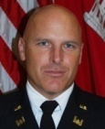
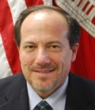
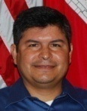
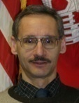
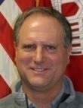
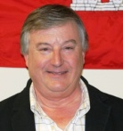
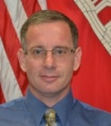
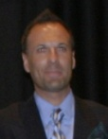
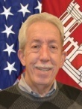
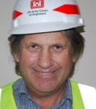
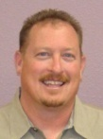
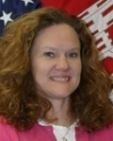
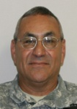
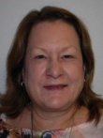



SPA Organization Chart
Commander
LTC
Antoinette
Gant
EXECUTIVE OFFICE
Deputy
Commander
MAJ
Gary Bonham
Planning Prog & Project Mgmt
John D’Antonio
Engineering &
Construction
John Moreno
Operations
Mark Yuska
Regulatory
Allan Steinle
448 Staff Members
430 Civilian
7 Military
11 Civilians Deployed
Real Estate (SPL)
Richard Rodier
National
Organizations
G&A
Readiness & Contingency
Ops
Jeff Daniels
Small Business
Daniel Curado
ULA
Jessie Griego (Acting)
Contracting
LTC Joseph Davis
Public Affairs
Mark Slimp
(Acting Chief)
Safety
James Jaffe
ACE-IT
Jack Ramsey
Office of
Counsel
LeeAnn Summer
Internal Review
MSG
Fernando Vasquez
EEO
Karen Doran
CHRA
Troy Wallis
Resource Mgmt
Elizabeth
McCullough
Workforce
Mgmt
Jeannette
Alderete

Slide 9
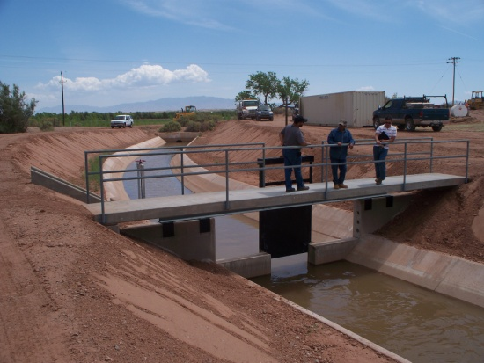
Civil Works Mission
OREGON
Obligations | FY12 | FY13 | FY14 | FY15
Investigations | $1.2M | $1.9M | $1.2M | $2.4M
Construction | $8.4M | $7.8M | $11.8M | $26.3M
O&M | $24.2M | $24.2M | $23.0M | $24.6M
Regulatory | $2.2M | $2.1M | $2.2M | $2.2M
FCCE | $0.9M | $0.6M | $0.6M | $0.6M
CW Total | $36.9M | $36.6M | $38.8M | $56.1M
IDAHO
WYOMING
NEVADA
UTAH
COLORADO
CALIFORNIA
SPA
SPN
SPK
SPL
ARIZONA
NEW MEXICO
TEXAS
Signature Projects
Espanola Valley, Rio Grande & Tribes, NM
Middle Rio Grande Flood Protection, Bernalillo to Belen, NM
Middle Rio Grande Restoration, NM
Middle Rio Grande ESA Collaborative Program, NM
Alamogordo, NM
Acequias Irrigation System, NM
Rio Grande Basin, CO, NM, TX
Rio Grande Floodway, San Acacia to Bosque del Apache, NM
Tribal Partnership Program

Slide 10
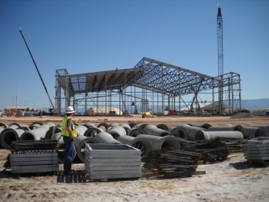
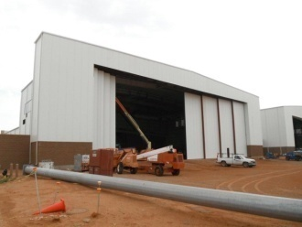
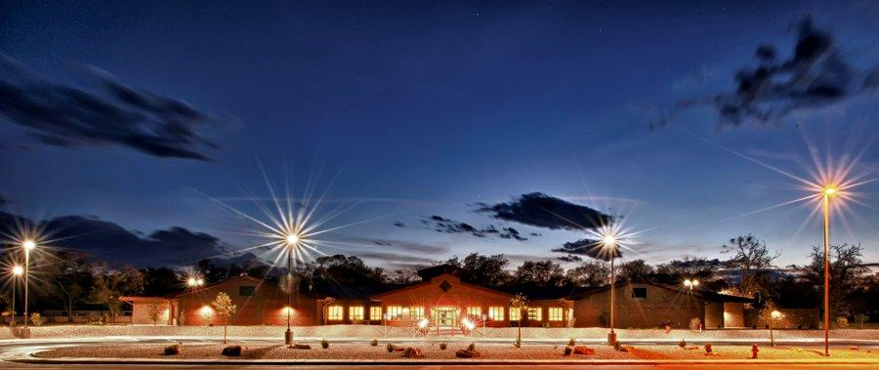
Military Mission
Obligations | FY12 | FY13 | FY14 | FY15
MILCON | $287.0 M | $119.6 M | $145.1 M | $124.1M
FSRM | $25.0 M | $25.0 M | $25.0 M | $12.2M
Environmental | $30.5 M | $30.0 M | $25.0 M | $30.0M
Military Total | $342.5 M | $174.6 M | $195.1 M | $166.3M
Environmental
Cannon AFB, NM
Holloman AFB, NM
Kirtland AFB, NM
Ellsworth AFB, SD
Nellis AFB, NV
FUDS (SPA & SPL)
NALEMP (Tribal)
White Sands Missile Range, NM
Yuma Proving Ground, AZ
Ft Bliss, TX
MILCON / FSRM
Cannon AFB, NM
Holloman AFB, NM
Kirtland AFB, NM
Davis-Monthan AFB, AZ
Nellis AFB, NV
Luke AFB, AZ
Signature Projects
FY10 CAFB Consolidated Comm Facility
FY10 CAFB SOF Fuel Cell & Corrosion Control Hangars
FY10-14 KAFB Bulk Fuels Facility Remediation
FY11 HAFB UAS Maintenance Hangar
FY12 CAFB SOF Maintenance Hangar/AMU
FY12 KAFB Nuclear Weapons Sustainment Facility
FY13 CAFB Replace Medical/Dental Clinic
FY 13 HAFB MQ-9 Maintenance Hangar
OREGON
OREGON
IDAHO
IDAHO
WYOMING
WYOMING
NEVADA
NEVADA
UTAH
UTAH
COLORADO
COLORADO
CALIFORNIA
CALIFORNIA
ARIZONA
ARIZONA
NEW MEXICO
SPA
SPK
SPL
NEW MEXICO
TEXAS
TEXAS
Notes:
FSRM Projections: The vast majority of the FSRM Program is at KAFB. KAFB is a “Tenant Base” with approx 250 tenants of which the district is currently serving approximately 10 of the major tenants including the BCE. Since the majority of the tenants the district currently serves are Research and Development it is not anticipated that the funding will reduce with fiscal constraints, based on discussions with those tenants.

Slide 11
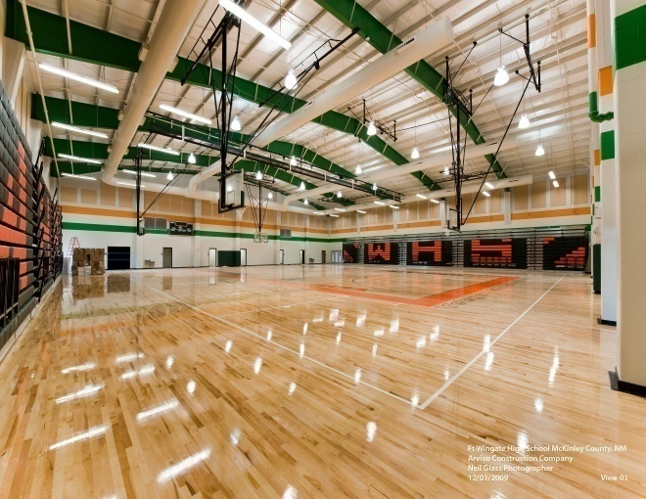
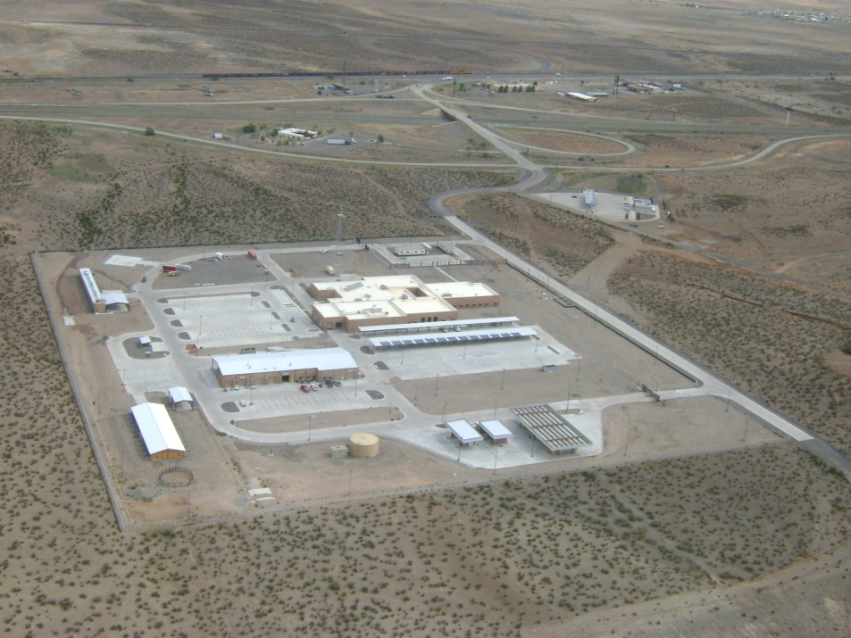
IIS Mission
Obligations | FY12 | FY13 | FY14 | FY15
DOE (NNSA) | $0.2M | $15.0M | $25.0M | $17.0M
DHS (CBP, ICE) | $64.1M | $10.0M | $36.0M | $10.0M
DOI (BIA) | $0.05M | $2.0M | $2.0M | $2.0M
Other | $0.01M | $0.05M | $1.0M | $1.0M
IIS Total | $64.4M | $27.0M | $63.0M | $30.0M
Wingate High School
Signature Projects
Clint Border Patrol Station, TX
Lordsburg Border Patrol Station, NM
ICE Co-location Facility, TX
Antelope Wells LPOE & FOB, NM
Animas FOB, NM
El Paso Sector R&A , TX
NNSA Capital Improvements
BIA Schools
Lordsburg BPS

Slide 12
Five SPA Focus Areas and Initiatives
Strategic Customer Relationship Development Plan
  IIS Customer Outreach
  Customer Care (Military)
  CW Strategic Engagement
  Tribal Communications
2. Workforce Shaping
  Workforce Dev/Retention
  Succession Plan
  Improve Readiness
  Cross Training
3. Leader Development
  Build the Bench
  Recruit and Retain
  Improve Engineer Regiment
4. Governance Processes and Priorities
  Work Acceptance
  Small Projects Proficiency
  Regionalization
  Improve Internal Communication
  Tribal Center of Expertise
5. Sustainability Program (Environmental)
  Reenergize Sustainability Program in SPA

Slide 13
District Challenges/Successes
Workforce/Workload Leveling (regionalization and core competencies)
Outreach Initiatives (UNM, 2nd EN BN, Sandia Labs, etc.)
Tribal Partnership Program (Center of Expertise)
Impacts to MilCon Program due to Furloughs
Civil Works Program due to untimely release of Work Plan

Slide 14
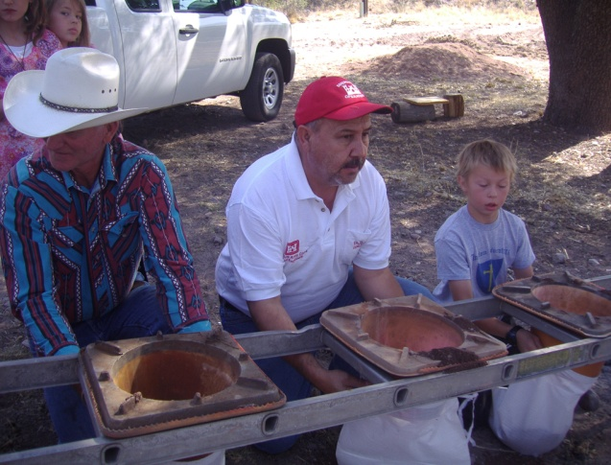
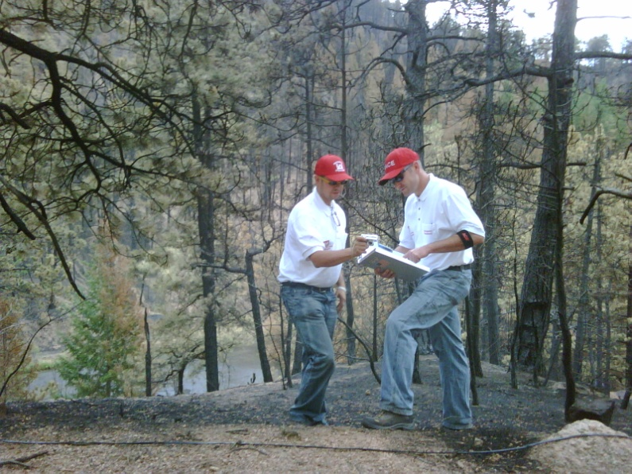
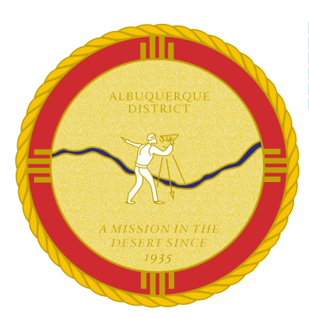
Final Thoughts
Building Strong
Inside and Outside the Walls of USACE!
Listen - Support - Educate
Notes:
14

Slide 15

QUESTIONS
Notes:
15

