Slide 1
Operations Division
Mark Yuska
Chief, Operations Division
Notes:
Good morning. I’m Beverly Noel-Chavez, Chief of Operations Support Branch for the Albuquerque District.
I’m here to talk about our missions, programs, and typical projects we accomplish, and showing a couple of potential projects we have coming up.
The U.S. Army Corps of Engineers has a number of important Civil Works missions, some of which we proudly carry out here in Albuquerque District.
Operations Division is primarily responsible for dams and lakes in Albuquerque District, and related operations, maintenance, and impacts of these important projects.

Slide 2
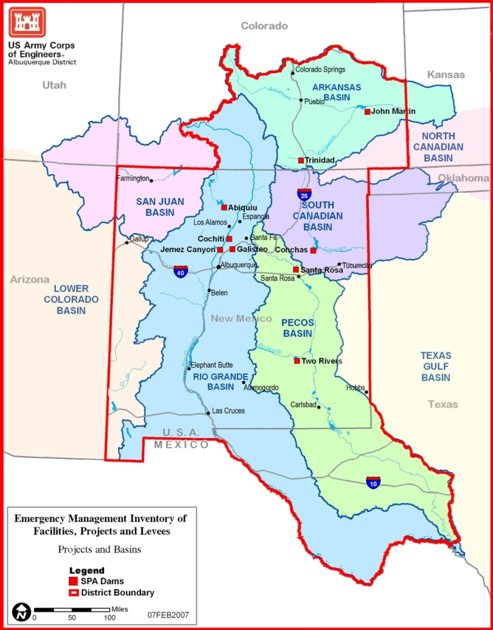
Corps Dams in Albuquerque District:
Arkansas Basin
  John Martin
  Trinidad
Rio Grande Basin
  Abiquiu
  Cochiti
  Galisteo
  Jemez Canyon
South Canadian Basin
  Conchas
Pecos Basin
  Santa Rosa
  Two Rivers
2
Notes:
Corps Districts are generally organized around hydrologic watershed basins. We include five watershed basins in Albuquerque District.
We operate and maintain dams in four of these five basins, shown by the red boxes on this map, and listed to the right.
Each of these dams and supporting facilities undergoes continuing operations and maintenance, funded by fiscal year budgeting.
Depending upon funding, we add non-routine projects that may be backlog maintenance or significant repairs or rehabilitations at the various locations.

Slide 3
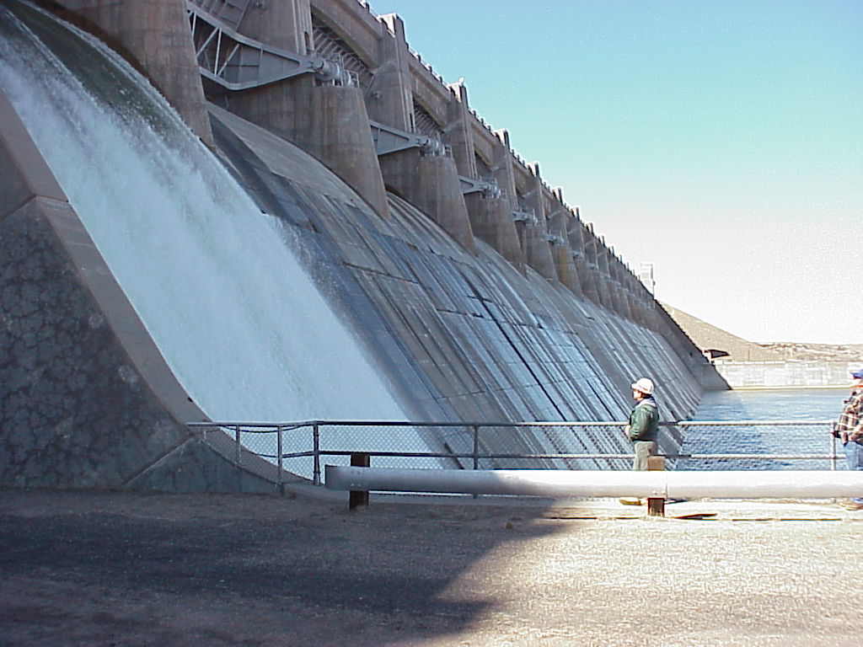
Operations Program
Flood Risk Management thru O&M of our nine dams
Water Control – storage and releases; District dams
Operate and maintain dams and supporting facilities
Provide for safe recreation with direct management of parks (Abiquiu, Cochiti) or partnership with state parks (Colorado; John Martin and Trinidad), (New Mexico; Conchas, Santa Rosa)
Accomplish environmental projects associated with impacts of these dams
Total Program normally about $25M per year recently
John Martin Dam, Southeastern Colorado
3

Slide 4
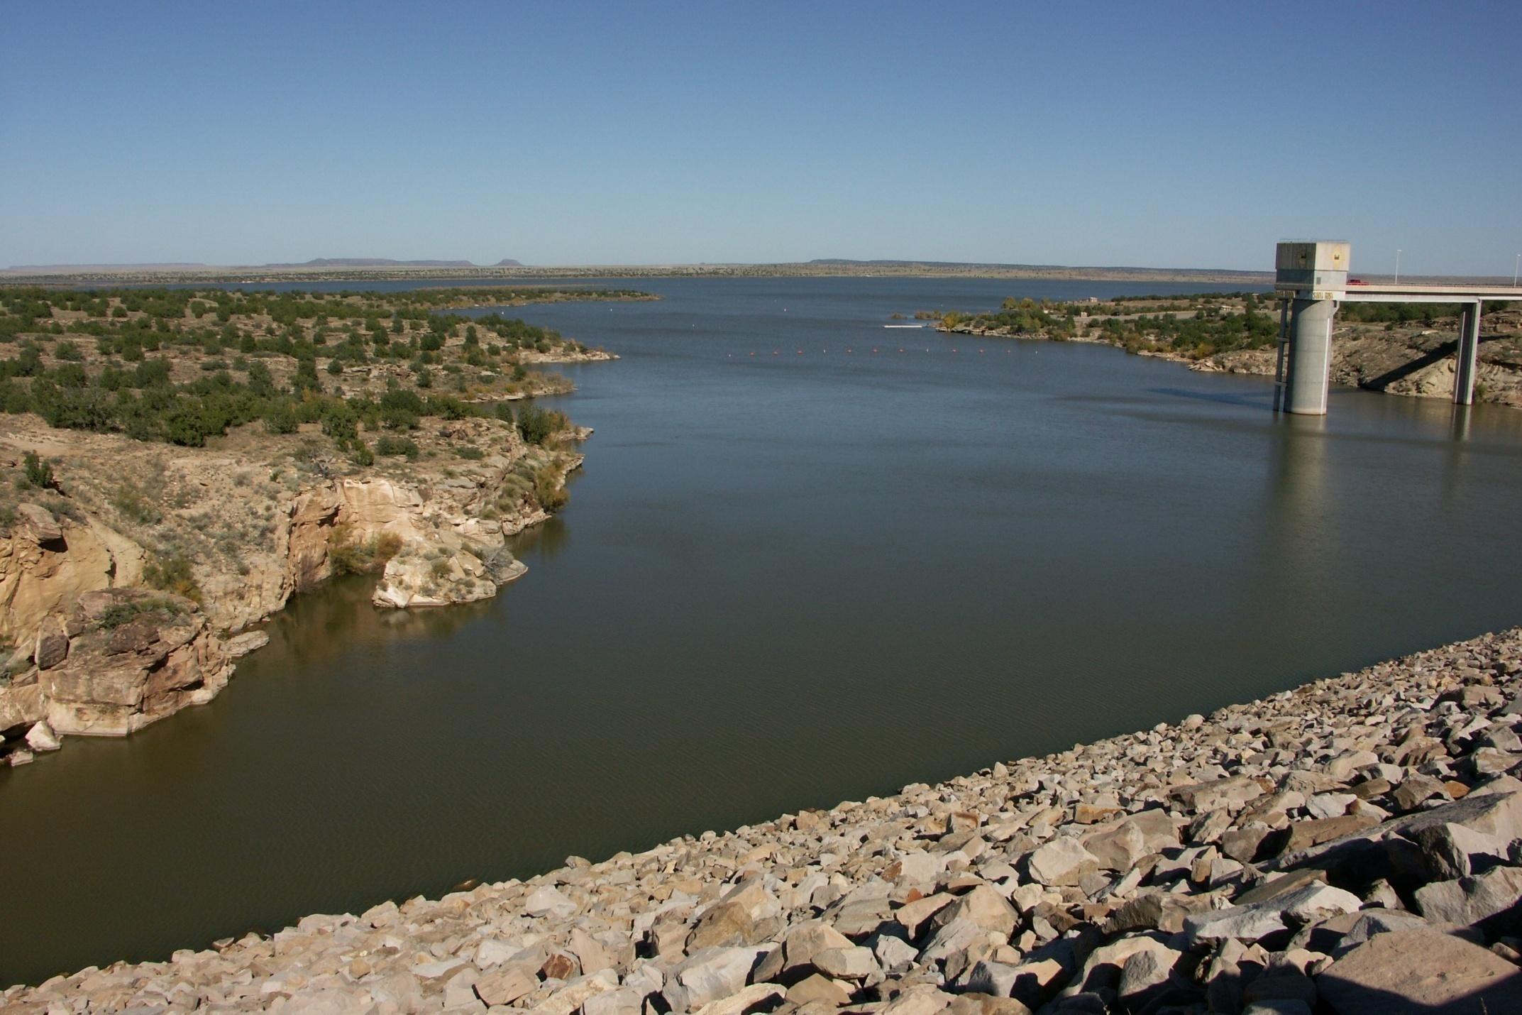
Operations Program Cont.
Operations and Maintenance of Corps dams, facilities, and related projects is funded by direct annual Congressional appropriations, unlike the customer-based projects of military and interagency construction.
Fund and support studies and special projects to plan for improved technology and operational methods to continually improve benefits to public and environment.
Provide Geospatial Products, Support, and Services to the District and External Partners/Customers
Santa Rosa Dam & Lake, Eastern NM
4

Slide 5
Operations Program Cont.
Typical maintenance work includes:
  Concrete repairs and replacements
  Buildings and facilities repairs and minor construction
  Electrical systems upgrades and replacements
  Repairing and re-paving roads
  Repairing and sealing large water outlet gates on dams
  Vegetation removals on dams
  Large rock and riprap placements
  Tamarisk (Salt Cedar) removal
  Dredging
  Building demolition
  Structural metal repairs and replacements
  Painting and coating metal surfaces in wet or humid environments
  Sediment and bathymetric surveys
  Green/”sustainability” projects reducing energy/water use
5

Slide 6
Operations Program Cont.
Contract Work, FY13 (1 Oct 2012 – 30 Sep 2013):
  Conchas Lake, NM: Roof repairs, Adobe Belle houses
  Two Rivers Dam(s): Vegetation removal
  Galisteo Dam, NM: Survey boundary
  John Martin & Trinidad Dams, CO: Small security and safety projects
Upcoming Contract Work, FY14:
  Conchas Lake, NM: Irrigation Headworks Erosion Control
  Cochiti Lake, NM: Spillway Erosion Repair
    (Subject to being funded)
Future years backlog maintenance projects:
  (As was listed in our “Typical maintenance work” slide)
  (All subject to being funded)
6

Slide 7
Corps’ Flood Control Mission
One of our most important Civil-Works missions is “Flood Risk Management”:
  In general; operating and maintaining and in some cases, constructing; levees, storm damage reduction projects, and dams
  Identifying and assessing flood hazards posed by aging flood damage reduction infrastructure,
  Improving public awareness and comprehension of flood hazards and risk
  Improving capabilities to collaboratively deliver and sustain flood damage reduction and flood hazard mitigation services to the nation.
7

Slide 8
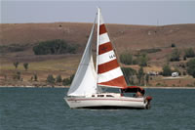
Corps’ Recreation Mission
Lesser known fact: We are the largest federal provider of outdoor recreation in the country:
  420 lakes in 43 states hosting 33% of all freshwater lake fishing
  $18 billion in total spending associated with Corps lake visits
  Translating to 350,000 jobs for American workers!!
In Albuquerque District (NM and southeastern CO)
  Nine Corps Dams, Six storing water year-round
  Over 30 recreation areas (campgrounds, hiking trails, etc.)
  Five-million total visitor-hours
  Annual visitor recreation spending
  Recreation-based jobs provided
8

Slide 9
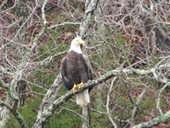
Corps’ Environmental Stewardship Mission
Along with projects providing flood risk management benefits, comes the responsibility to mitigate for their effects
  Estimated 112,000-acres of land managed
  Estimated 210 miles of shoreline
  Habitat work around the lakes
  Archaeological and paleontological sites preserved
  Historical structures
9

Slide 10
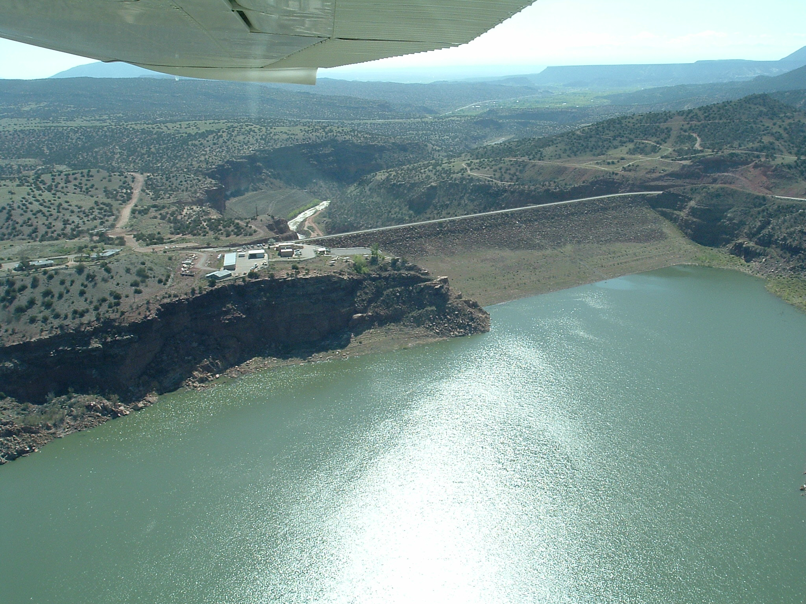
Thank You For Attending!
Abiquiu Dam & Lake, Rio Chama, Northern NM
10

Slide 11

QUESTIONS
Notes:
11

